Slide 1

Introduction à la
programmation informatique
Notes:
This project was supported by a grant from CIRA's Community Investment Program.

Slide 2
Inspirer & Outiller
les enfants canadiens avec la programmation informatique
Nous sommes un organisme canadien à but non lucratif canadien se consacrant à outiller les élèves, les enseignants et les parents avec des compétences qui les aideront à prospérer dans une société axée sur la technologie.
À travers la programmation, nous enseignons aux enfants comment mieux penser et créer dans un monde numérique.
Notes:
Empower is translated as outiller (Cand. Fr.) when it refers to technology in education: http://www.granddictionnaire.com/ficheOqlf.aspx?Id_Fiche=8349600&MotClef=outiller&RechercheDans=2&Id_TypeRecherche=1&Id_LangueInterro=***&Domaine=

Slide 3
Qu’est-ce qu’un ordinateur?

Slide 4

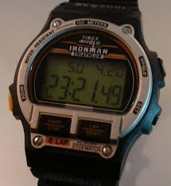

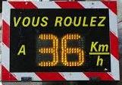
Un ordinateur est une machine programmable qui peut
enregistrer
récupérer
traiter des données
Notes:
Adults (and especially teachers) employ these practices all the time! What are examples of these practices in day-to-day life?
Experimenting: Cooking/Baking: improving a recipe, trying different combinations…
Collaboration: For most things in life, you collaborate with others. For example in this workshop: (to the participants) You are being quiet, listening and participating. As the instructor, I am standing, speaking clearly and answering your questions.
Planning:
We usually plan things out when tasks are complex or unfamiliar. Ex.: For instance, how did you get here today? (for workshops that are not being held in the school) It is important to have a clear idea of what you are trying to accomplish.
Debugging: We all do this without thinking, it’s known as auto-correction (we see that we’ve made a mistake, we correct it and keep on going). Say when you’re parking your car, and you need to “re-adjust” or you buttoned your shirt and missed a button.

Slide 5
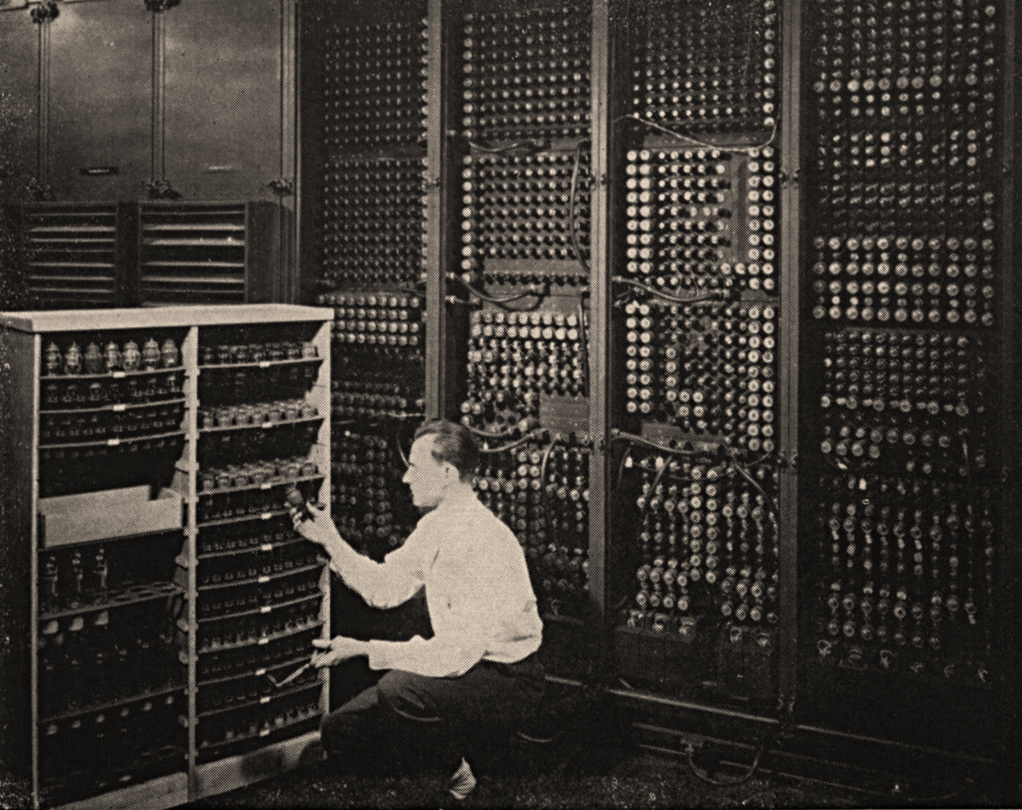
Un ordinateur est composé de
Matériel disque dur, mémoire, …
Logiciels programmes informatiques
ENIAC (Electronic Numerical Integrator And Computer) 1946 -1955
Notes:
http://www.computerhistory.org/revolution/birth-of-the-computer/4/78: ENIAC
Background: ENIAC – Replacing a bad tube meant checking among the computer’s 19 000 possibilities.

Slide 6
Que veut dire le mot CODE pour vous?
Notes:
Question to the audience: Name types of codes other than computer programming?
Some answers
Code of conduct
Code of ethics
Dress code
Morse code
Emoticons
Facial expressions
Languages (spoken, written, sign)
Colour codes
The word code means many things to many people. Secret codes, codes of conduct, codes that organize information, like colour coding, or codes that tell us what to do in a crisis. Humans seem to be built to code and de-code. If you’ve learned to read, learned basic math, learned a recipe, you’ve already developed some coding skills that you can transfer to the project of learning computer code.
So, you already know how to code, you are simply learning one more way to do it.

Slide 7
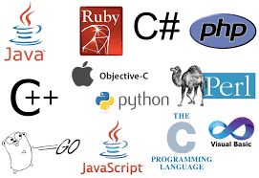



Le CODE en informatique
représente ce que nous demandons à un ordinateur de faire (et quand).
Notes:
Comment on donne des instructions à un ordinateur.
Humans are built to code and de-code information.
If you’ve learned to read and write, learned basic math, learned a recipe, you’ve already developed some coding skills that you can transfer to the project of learning computer code.
YOU ALREADY KNOW HOW TO CODE!
You are just learning one more way to do it.

Slide 8




LA PENSÉE
< Planification >
< Collaboration >
< Expérimentation >
< Débogage >
<PRATIQUES>
INFORMATIQUE
{CONCEPTS}
{ Algorithmes }
{ Décomposition }
{ Abstraction }
{ Reconnaissance
de Schémas }
{ Logique }
/PERSPECTIVES/
/ Expression /
/ Compréhension /
/ Connexion /
Notes:
Instructor notes Introduce this as the big picture. Three key dimensions to Computational Thinking (Brennan & Resnick, AERA 2012): computational concepts, computational practices, computational perspectives
They are concepts that you already master, whether formally or not (you may be better at some than others…which is true for everyone)
Explain it clockwise: Computational concepts put into action are Practices, and that leads to Perspectives.
Explain to teachers that even though some of these concepts might seem like a giant black-hole now, they already use and understand many of them daily as we will see in next set of slides
End on Perspectives as the reason why we would want to learn and teach computational thinking,
Concepts Concepts that designers use as they program; these concepts are common to all programming and transfer to non-programming contexts
Algorithm: a series of step-by-step instructions
Decomposition: breaking down a complex problem into simpler parts
Abstraction: keeping essential characteristics/information (from the latin abs- “away from” and “trahere” -draw)
Logic: Analyzing and predicting
Pattern Recognition: learning to identify and use similarities in order to: simply, shorten, apply similar solutions
Practices:
Practices designers develop as they program: it is the process of construction and design. Practices focus on the process of thinking and learning, moving beyond the “what” you are learning to the “how” you are learning.
Experimenting: trial and error, testing new things, having an idea and trying to see how to make it work (incremental & iterative process)
Debugging: Answering the question “Does it work the way I want it to?” If the answer is “No”, figure out why then fix it. (incremental & iterative process)
Collaboration:
Planning:
Perspectives:
Designers evolve their understanding of the technological world around them, their relationship with others, and of themselves.
Expressing = computer programming can be a means of expressing oneself because it is a tool, it can be used in many different ways (web pages, art, music, games, etc…) just like a pencil can be used to write a report or draw a picture.
Understanding = being better able to understand today’s sociotechno reality - being able to recognize and use some of the tools that create this reality
Connecting = creativity and learning are deeply social practice, facilitate being able to reach out to others in a new ways (creating with others and creating for others)

Slide 9


RECETTE
Algorithme
Une série ou séquence d’instructions, étape par étape
Notes:
What are examples of every day algorithms?
Following a recipe, brushing your teeth, getting dressed (yes you can put your socks on before your pants but underwear goes on before outerwear!), starting your car…
Other examples:
Building with clear stages: snowman
bedtime/sleep routine
Planting a seed
In a classroom, the one algorithm everyone needs to know and follow: What to do when the fire alarm sounds.
Let’s take a minute to make sure what everybody is operating from the same set of step-by-step instructions.
What’s your fire drill?

Slide 10
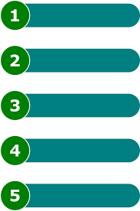
Enseigner à la classe…
Décomposition
Réduire un problème complexe en éléments simples
Notes:
We all do this in our everyday lives, we are simply not conscious of it. Example: “Teach the class” that is a complex problem… Question: How do you break it down into smaller parts?
Potential “simpler” parts…
Plan your day
Get to school
Go to your class at a specific time
Prepare your class/material
Take attendance
Start the class
Is there a test today? Yes – give instructions.
Etc..
Being able to break a problem down into small parts is a very important skill.
Can you think of a time recently when you broke a problem down to make it easier?
Cleaning a room one section at a time,
Préparation du réveillon de Noël
Making a snowman: make the pieces first and put them together
puzzles: making the edges first
murals: each person does a little part

Slide 11

Reconnaissance de schémas
Apprendre à identifier et utiliser des similarités pour
Simplifier
Raccourcir
Appliquer des
solutions semblables
Notes:
Exemple classique de reconnaissance de formes/modèles/schemas (pattern recognition)
Vase/candlestick (cultural context) vs, two faces.
The first time you saw this, chances are you didn’t see both: someone had to point the alternative out to you.
Q. What are other examples of pattern recognition?
A. Possibilities include…
Facial Expressions!
Poetry: rhymes
Music: melodies, harmonies, chorus
Chess: how the pieces move

Slide 12


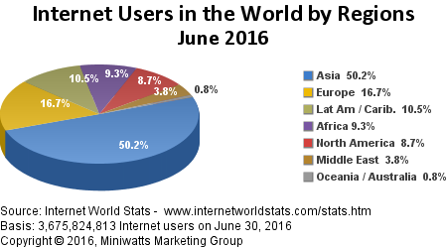
Abstraction
Réduire à un ensemble
de caractéristiques
essentielles
Résumer
Modèles non réalistes
Notes:
“Abstract” comes from the latin “abs-” = away from and “trahere” = draw. Abstraction is taking away/removing in order to reduce something to a set of essential characteristics (established by convention). Focus on the essentials then add to details in order to make it essential/important information more accessible/understandable: colours, shapes, textures, numbers…
What do these images have in common?
They are all non-realistic representations of things. There are established conventions so that we can communicate and recognize the representation as being the same thing. Globe: We recognize the shape right away, but what if it were red? Then what planet would we be looking at? Cat: We can all agree it is a cat, what would it take to make it a tiger? It’s already orange… Pie Chart: The data is already abstract: a column of numbers. The essential information is there, however by changing the representation, we make it easier to understand, to visualize the whole/bigger picture.
Computer animation is a very common form of computational abstraction: it is one of the ways we use programming as a means of expression.

Slide 13

Mise en pratique de
la reconnaissance de modèles
et
d’abstraction
Notes:
Pattern recognition & Abstraction:
Q. What do you see?
“ 2 triangles, 3 circles”
Point out that none of the shapes mentioned are fully drawn!
Pattern recognition: We have learned to identify them by being exposed to the shapes, by practicing and by being corrected (immediate feedback)…remember how you teach a child shapes!
Abstraction: We look for certain essential characteristics…
If the title of the slide had been “classic computer games” or you grew up only looking at video games, what would you see? Pacman!

Slide 14
Logique
Analyzer
et prédire (cause & effet)
Défi de pensée informatique:
Si aujourd’hui c’est vendredi, quel est le jour après le jour avant le jour avant demain?
Notes:
Logic is using what we know to analyze what we observe and predict what should occur: cause and effect.
Computational thinking challenge: Show the challenge and ask immediately “Is this a simple question?”

Slide 15
Mise en pratique:
décomposition,
logique
et
reconnaissance des schémas
Si aujourd’hui c’est vendredi, quel est
le jour après
le jour avant
le jour avant
demain
Notes:
What about looking at it differently? Let’s change the formatting…
Logique appropriée et non appropriée

Slide 16
Mise en pratique:
décomposition,
logique
et
reconnaissance des schémas
Si aujourd’hui c’est vendredi, quel est
le jour après
le jour avant
le jour avant
demain
Notes:
What about looking at it differently? We can change the formatting some more: Which do you find easier to understand: the first or the second organization of information? Why? Now let’s solve it! Let the participants work it out, Raise your hand when you’re ready…(gives everyone a bit of time) There are two ways to solve it: start with “tomorrow” and work your way up, or start from “the day after” and work your way down.
Answer: it’s today = Friday! Did you notice the pattern?
“day after + day before” and then
“day before + tomorrow” which can be substituted with “day before + day after” so these two lines cancel each other out... Indenting allows you to see the “inside-out”, “bottom-up” possibilities more easily and is something that is widely used in computer programming languages as a way to organise the code.

Slide 17
Mise en pratique:
décomposition,
logique
et
reconnaissance des schémas
Est-ce que ce problème est simple maintenant?
Si aujourd’hui c’est vendredi, quel est (le jour après (le jour avant (le jour avant (demain))))?
Notes:
Now that you’ve worked through it and solved it, here’s one final way of looking at it. Let’s change the formatting slightly… Adding parentheses is a concise way of decomposing the problem, each set indicates a new line (and an indentation)… How is this useful? (go to next slide)

Slide 18
La pensée informatique en action!
Décomposition
Logique
Reconnaissance de schémas
Algorithme
Si aujourd’hui c’est vendredi, quel est le jour après le jour avant le jour avant demain?
Notes:
(Computational thinking challenge: recap) Let’s recap: Is this a simple problem to solve now? Note I asked whether it was simple, not whether it was easy… You have worked through it and learned how to do it: it may not be easy but it has become simple.
Now when you are given a similar problem, you have various strategies to solve it… Write it out again on different lines or….put in the parentheses and remember that they represent new lines. So now, you can go home and figure out the problem with parentheses - that’s right practice will always help consolidate learning! What have you gained from working on this complex problem? We have improved our skills in decomposition, logic and pattern recognition and learned a new algorithm to solve the problem the next time a similar problem is encountered… Yes, all with one small and complex challenge and a little help!

Slide 19


Pratiques
Planification
Collaboration
Expérimentation
Débogage
Notes:
Adults (and especially teachers) employ these practices all the time! What are examples of these practices in day-to-day life?
Experimenting: Cooking/Baking: improving a recipe, trying different combinations…
Collaboration: For most things in life, you collaborate with others. For example in this workshop: (to the participants) You are being quiet, listening and participating. As the instructor, I am standing, speaking clearly and answering your questions.
Planning:
We usually plan things out when tasks are complex or unfamiliar. Ex.: For instance, how did you get here today? (for workshops that are not being held in the school) It is important to have a clear idea of what you are trying to accomplish.
Debugging: We all do this without thinking, it’s known as auto-correction (we see that we’ve made a mistake, we correct it and keep on going). Say when you’re parking your car, and you need to “re-adjust” or you buttoned your shirt and missed a button.

Slide 20
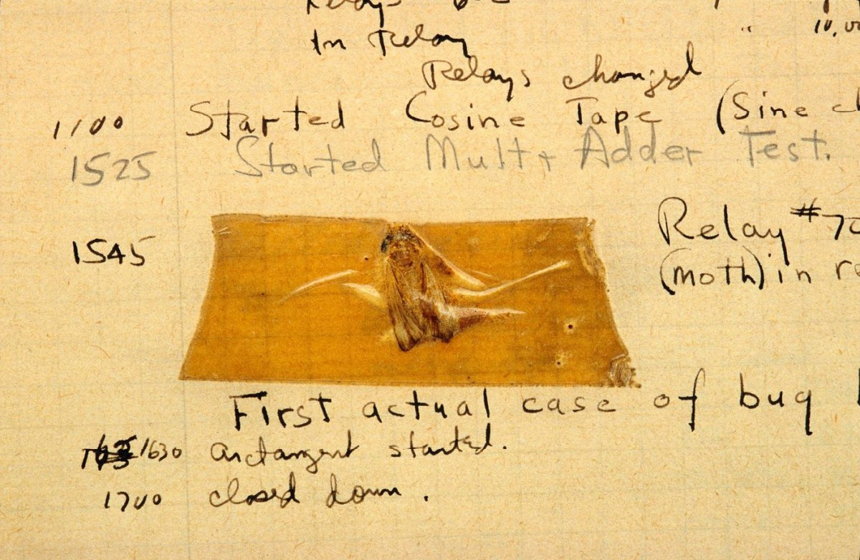
Le premier “bug” informatique
DÉBOGAGE
Est-ce que qu’il fonctionne comme il devrait? Identifier le pourquoi et le corriger, ou trouver comment le contourner.
Du journal de bord de Grace Hopper, 1947
Notes:
Debugging: We all do this without thinking, it’s known as auto-correction (we see that we’ve made a mistake, we correct it and keep on going). Say when you’re parking your car, and you need to “re-adjust” or you buttoned your shirt and missed a button.
Debugging: Answering the question “Does it work the way I want it to?” If the answer is “No”, figure out why then fix it. (incremental & iterative process)
Things rarely (if ever) work just as imagined, it is critical for designers to develop strategies for dealing with - and anticipating – anticipating problems.
Auto correction
A little trivia:
This is the very first instance of a computer bug: a moth found in the computer - from Grace Hopper’s blog
Grace Hopper, a famous computer scientist, is credited for coining the term “debugging”. In Computer programming, debugging means getting rid of problems in the code. One of Grace Hopper’s computer glitches was actually being caused by a moth in the back of her computer! Debugging has become a very important programming technique because the more code there is, the more potential for bugs there are!
Computer programmers usually say: If your program runs perfectly the first time, ask yourself the question “Why did it work?”

Slide 21
Équipes de deux
Un papier et un crayon pour chaque équipe
Désigner - un programmeur - un ordinateur
« Ordinateurs » Tournez le dos. « Programmeurs » Regardez l’image dans l’enveloppe et cachez-la.
Sur le signal… « PROGRAMMEUR » En utilisant uniquement des formes géométriques, donnez des instructions afin de reproduire l’image « ORDINATEUR » Suivez les instructions de votre programmeur à la lettre!
Programme-moi…

Slide 22

Formes géométriques seulement!

Slide 23
On change les rôles!
Notes:
52

Slide 24
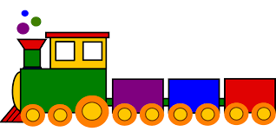
Formes géométriques seulement!

Slide 25
Naviguez:
http:// scratch.mit.edu
Créez votre compte
1, 2, 3 On y va!

Slide 26
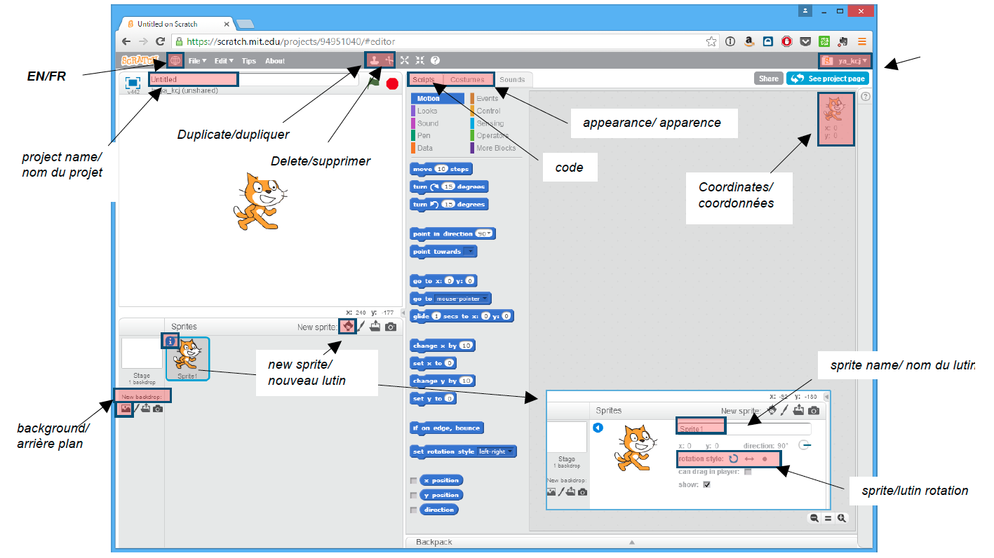

Slide 27
Questions? Suggestions? Nous aimerions beaucoup recevoir vos commentaires! educators@kidscodejeunesse.org
www.kidscodejeunesse.org

Slide 28
Nous aimerions beaucoup recevoir vos commentaires!
Lien pour le sondage
Nom de l’instructeur educators@kidscodejeunesse.org
www.kidscodejeunesse.org

Slide 29
Perspectives
Notes:
We are surrounded by technology and interactive media however, most of our experiences are as consumers.
Developing computational thinking practices and learning the concepts leads to insights and perspectives about technology.
Perspectives:
Designers evolve their understanding of the technological world around them, their relationship with others, and of themselves. Expressing Computer programming can be a means of expressing oneself because it is a tool, it can be used in many different ways (web pages, art, music, games, etc…) just like a pencil can be used to write a report or draw a picture. “I can create” and “I can express my ideas through this new medium”
Understanding
Creating awareness to be better able to understand today’s socio-techno reality. Being able to recognize and use some of the tools that create this reality
Connecting Creativity and learning are deeply social practices. Computational thinking facilitate being able to reach out to others in a new ways: creating with others and creating for other.

Slide 30
LA PENSÉE
< Planification >
< Collaboration >
< Expérimentation >
< Débogage >
<PRATIQUES>
INFORMATIQUE
{CONCEPTS}
{ Algorithmes }
{ Décomposition }
{ Abstraction }
{ Reconnaissance
de Schémas }
{ Logique }
/PERSPECTIVES/
/ Expression /
/ Compréhension /
/ Connexion /
Notes:
Instructor notes Introduce this as the big picture. Three key dimensions to Computational Thinking (Brennan & Resnick, AERA 2012): computational concepts, computational practices, computational perspectives
They are concepts that you already master, whether formally or not (you may be better at some than others…which is true for everyone)
Explain it clockwise: Computational concepts put into action are Practices, and that leads to Perspectives.
Explain to teachers that even though some of these concepts might seem like a giant black-hole now, they already use and understand many of them daily as we will see in next set of slides
End on Perspectives as the reason why we would want to learn and teach computational thinking,
Concepts Concepts that designers use as they program; these concepts are common to all programming and transfer to non-programming contexts
Algorithm: a series of step-by-step instructions
Decomposition: breaking down a complex problem into simpler parts
Abstraction: keeping essential characteristics/information (from the latin abs- “away from” and “trahere” -draw)
Logic: Analyzing and predicting
Pattern Recognition: learning to identify and use similarities in order to: simply, shorten, apply similar solutions
Practices:
Practices designers develop as they program: it is the process of construction and design. Practices focus on the process of thinking and learning, moving beyond the “what” you are learning to the “how” you are learning.
Experimenting: trial and error, testing new things, having an idea and trying to see how to make it work (incremental & iterative process)
Debugging: Answering the question “Does it work the way I want it to?” If the answer is “No”, figure out why then fix it. (incremental & iterative process)
Collaboration:
Planning:
Perspectives:
Designers evolve their understanding of the technological world around them, their relationship with others, and of themselves.
Expressing = computer programming can be a means of expressing oneself because it is a tool, it can be used in many different ways (web pages, art, music, games, etc…) just like a pencil can be used to write a report or draw a picture.
Understanding = being better able to understand today’s sociotechno reality - being able to recognize and use some of the tools that create this reality
Connecting = creativity and learning are deeply social practice, facilitate being able to reach out to others in a new ways (creating with others and creating for others)

Slide 31
Perspectives
Expression
Compréhension
Connexion
Apprendre la programmation informatique est un des meilleurs moyens de développer la pensée informatique.
Notes:
Learning computer programming or “learning to code” is one of the ways that we put concepts into action (practices) and gain important insights and perspectives about how we can best use technology.
The goal of learning to code (a skill) , should be to develop computational thinking (the competence) and spark a growth in perspectives such as:
- Programming can be used as a means of expression,
- Learning to code can lead to better understanding of socio-techno reality and help us learn and negotiate those realities
- Allows us to look further to seek connections: whether it be for help, to find people who share ideas with, to communicate, etc…

Slide 32

Ce projet a été financé par le Programme d’Investissement Communautaire ACEI.

